Slide 1
Using Non-Isolated Leptons in the Search for New Particles at the LHC
Alice Sady
Advisor Petar Maksimovic
Johns Hopkins University
Oct 8, 2014

Slide 2
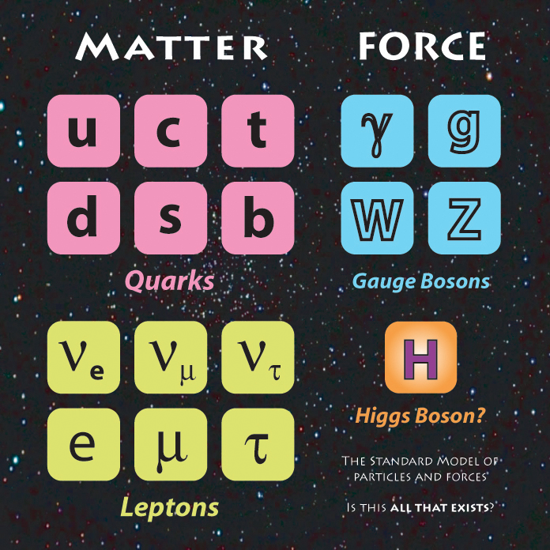
What do we know about particles so far?
Molecules
Atoms
Protons
Electrons
uud
http://deskarati.com/2012/01/09/peter-higgs/
1
Notes:
Study of smallest non-composite objects
Molecules>Atoms>Protons/electrons>.Quarks
Why->Analyzing universe we live in – experimental applications in many different fields as well
2 types of SM particles
One newly discovered particle!

Slide 3
What is the Standard Model (SM) missing?
SM shortcomings:
Missing dark matter, dark energy, and gravity
Matter-antimatter asymmetry
Predicts massless neutrinos
Hierarchy problem
How do we go about solving these mysteries?
Create new models to predict new particles
Look for new particles and study their properties
2
Notes:
Study of smallest non-composite objects
Molecules>Atoms>Protons/electrons>.Quarks
Why->Analyzing universe we live in – experimental applications in many different fields as well
2 types of SM particles
One newly discovered particle!
----- Meeting Notes (10/6/14 14:44) -----
matter anti matter - result from AMS?

Slide 4
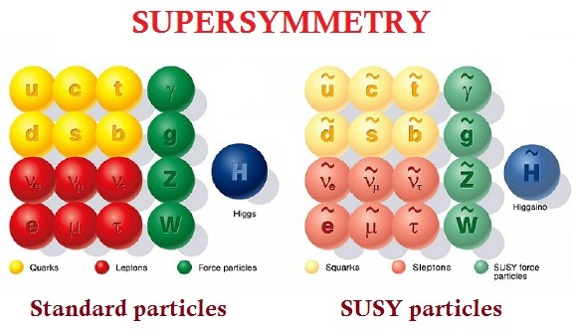
What are we looking for?
http://www.simonsfoundation.org/wp-content/uploads/2012/11/Susy-particles.jpg
3

Slide 5
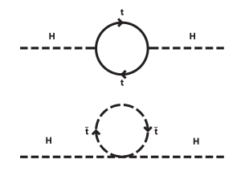
How does SUSY solve the hierarchy problem?
Hierarchy problem – m_{H} should be order m_{Λ}
In SM, corrections to square of Higgs mass require precise cancellation of infinites to get experimentally observed Higgs mass
SUSY particles could cancel these infinities “naturally” if higgsinos, stops, and sbottoms are ~1 TeV or less
http://upload.wikimedia.org/wikipedia/commons/thumb/6/68/Hqmc-vector.svg/300px-Hqmc-vector.svg.png
4
Notes:
Why would we expect the falsities

Slide 6
What else does SUSY solve?
R-Parity
SM particles: + 1
SUSY particles: - 1
Assumption of most searches: R-parity conserved
If R-parity conserved, lightest SUSY particle doesn’t decay, providing dark matter candidate
Signals expected to have large missing energy – easy to discriminate from background
5
Notes:
-expand on R-parity conserved SUSY and how we searched for it – dark matter candidate etc.

Slide 7
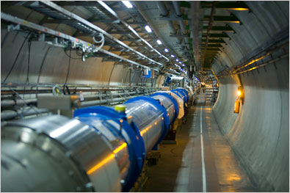
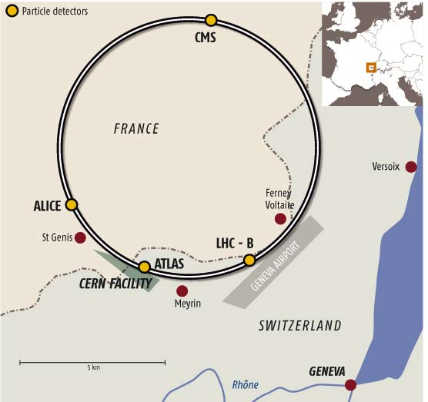
How do we look for SUSY?
Goal: Collide protons to probe high-energy scales to test SM and look for beyond the SM physics
http://topics.nytimes.com/top/news/science/topics/large_hadron_collider/index.html http://www.newscientist.com/article/dn7410-particle-smasher-gets-a-superbrain.html
6

Slide 8
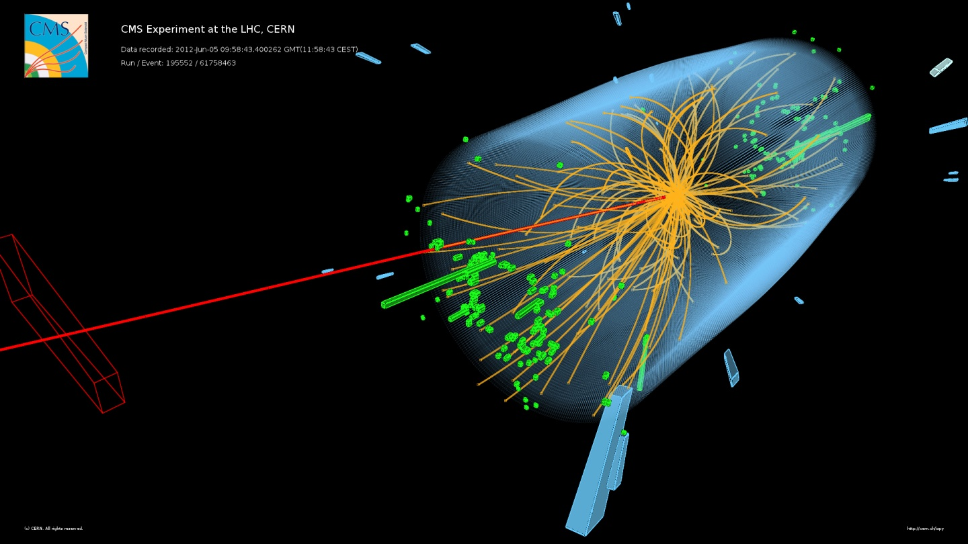
What do proton proton collisions look like?
p
Beam collision
p
http://www.quantumdiaries.org/wp-content/uploads/2013/12/CMS-Htautau1.jpg
7

Slide 9
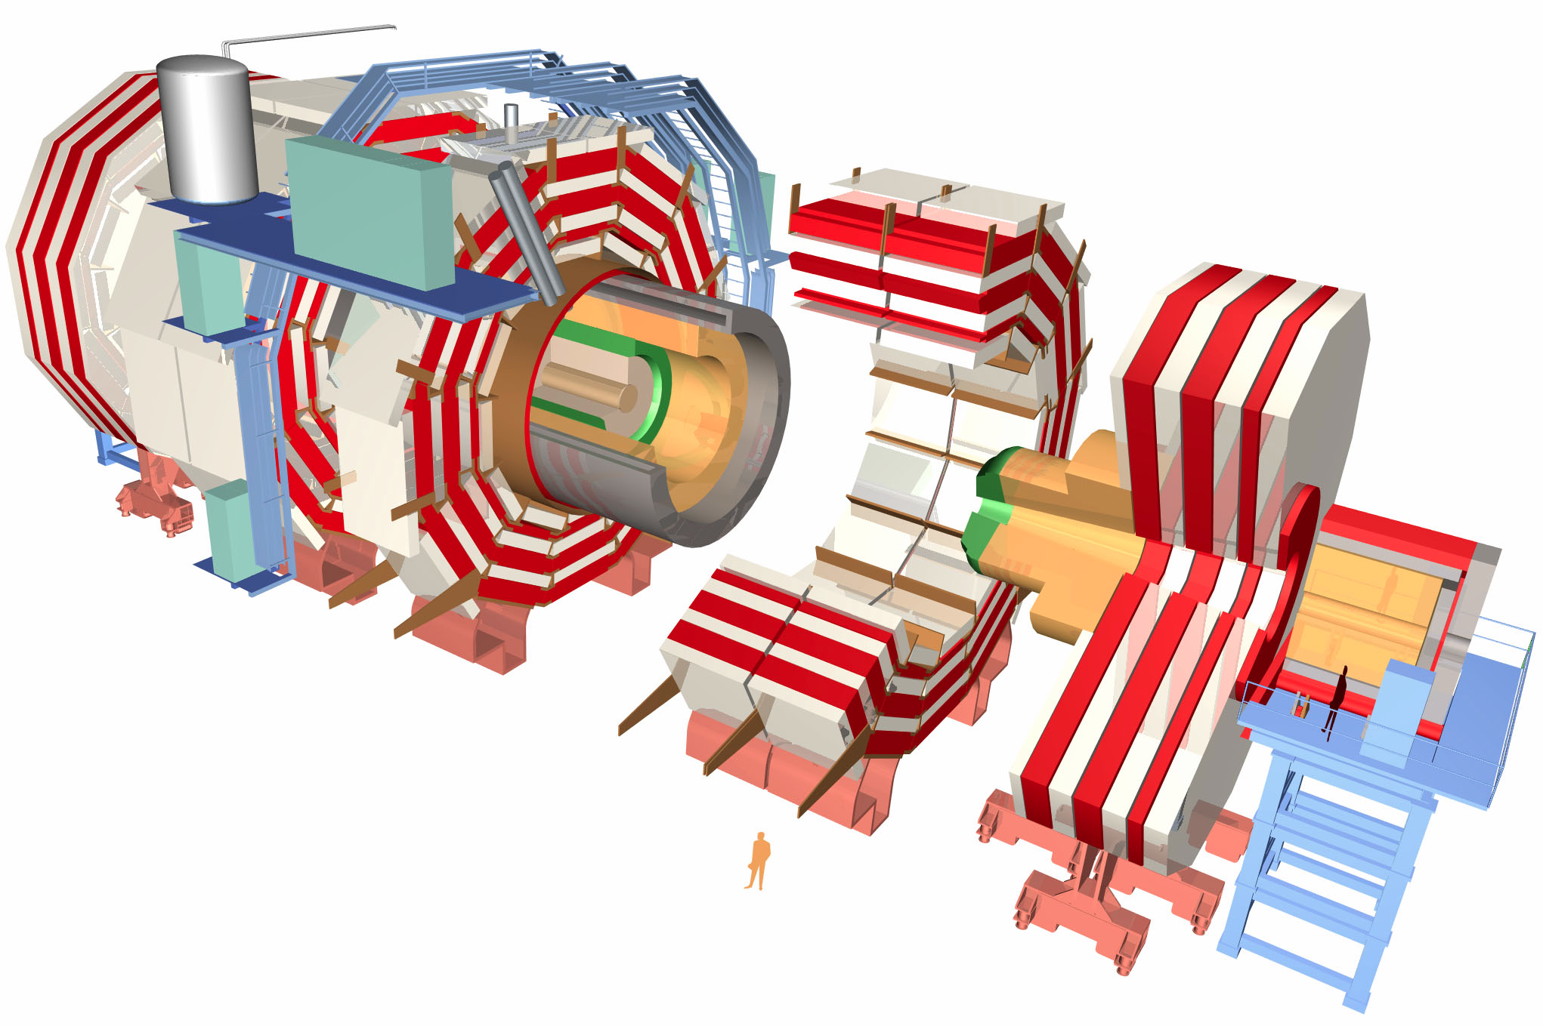
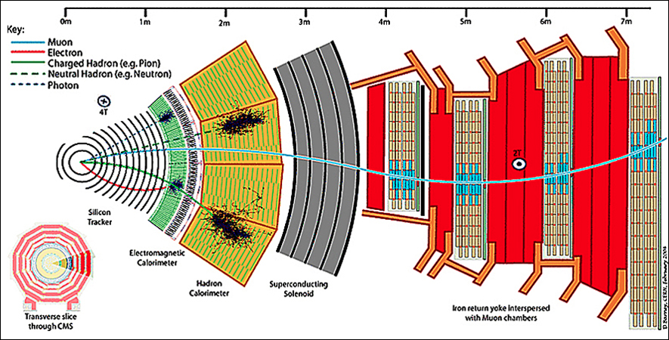
How do we measure the results of proton-proton collisions?
Compact Muon Solenoid detector: different particles leave different tracks read out by detector and processed for physicists to analyze
http://www.particlecentral.com/images/cms_slice.jpg
http://cms.desy.de/sites/site_cms/content/e48942/detector.jpg
8

Slide 10
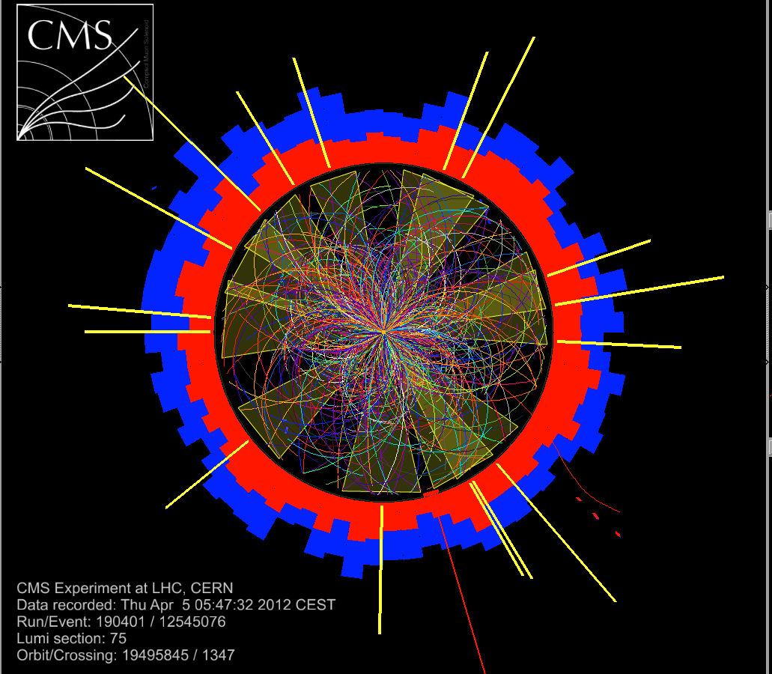
Why haven’t we found SUSY yet?
Masses too heavy
OR
RP-violating SUSY: lightest SUSY particle can decay to SM particles
Buried under heavy amounts of hadronic activity at LHC
Parameter space not ruled out even at 8 TeV
http://cms.web.cern.ch/sites/cms.web.cern.ch/files/styles/large/public/field/image/cms2012-2.png?itok=aEqCrCDL
9

Slide 11
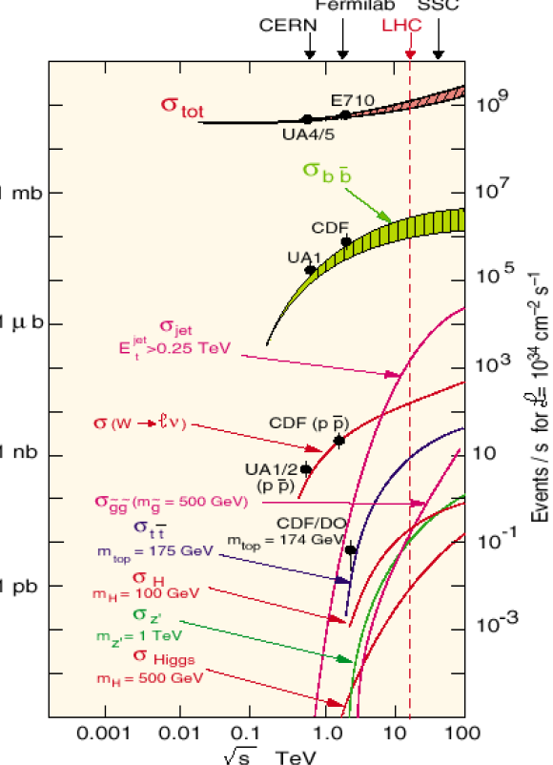
How hard is it to find SUSY?
uninteresting
Cross section measured in barns
Amount of data measured in inverse barns (pb⁻¹, fb⁻¹...)
new particles
10

Slide 12
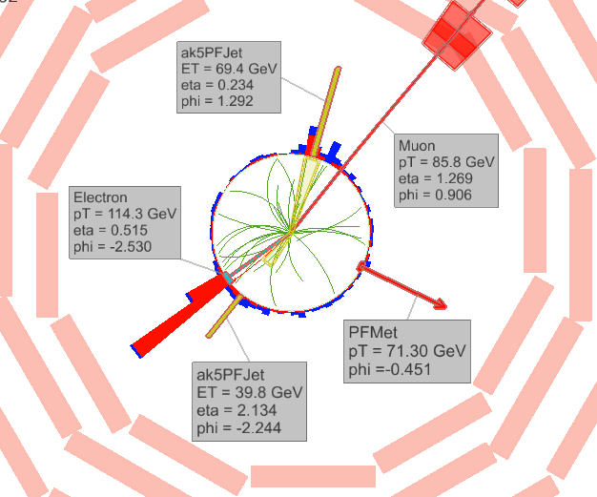
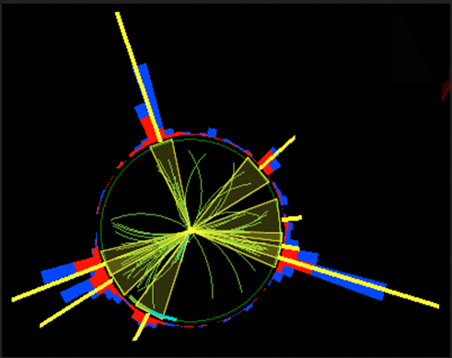
How do we discriminate leptonic RPV SUSY from background?
Lepton Isolation
Nonisolated Leptons
Isolated Leptons
Picture of b-jet decay
http://cms.web.cern.ch/sites/cms.web.cern.ch/files/styles/large/public/field/image/TOP12035_Event01.png?itok=uicy0R2T
http://faculty.ucr.edu/~ellison/
11
Notes:
Study of smallest non-composite objects
Molecules>Atoms>Protons/electrons>.Quarks
Why->Analyzing universe we live in – experimental applications in many different fields as well
2 types of SM particles
One newly discovered particle!

Slide 13

Why wouldn’t we use lepton isolation as a discriminant?
q
q
p
X
Y
l
m_{X} >> m_{Y}
q
p
X
q
Y
l
Boosted signal: lepton and quark merge in detector
Fails current isolation requirements
Missing signals at 8 TeV and in danger of missing even more at 13 TeV
Our Goal: find a boost-invariant discriminant
12
Notes:
Study of smallest non-composite objects
Molecules>Atoms>Protons/electrons>.Quarks
Why->Analyzing universe we live in – experimental applications in many different fields as well
2 types of SM particles
One newly discovered particle!

Slide 14
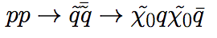
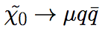
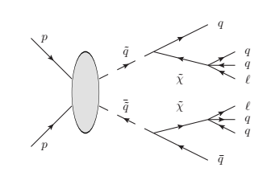
What can we look for?
First compare signals with different mass points to background for different discriminants
Require 2 leptons and 2 jets with small p_{T} requirements
13

Slide 15
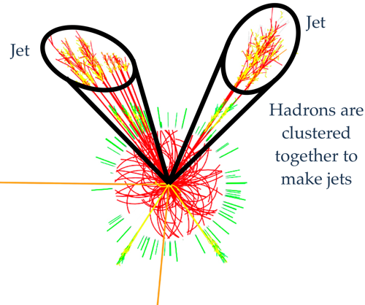
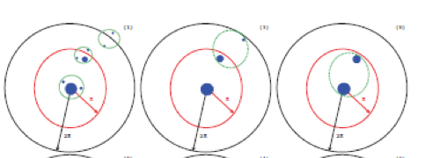
How do we define jets and jet substructure?
Distance measured in ΔR² = Δη² + Δφ²
Cluster jets (Cambridge Aachen algorithm)
Pair closest particles until ΔR = 0.8
Cluster subjets (exclusive k_{T)}
Pair closest particles inside jet until n pseudoparticles are left
n=3 since neutralino has three decay products
http://pages.uoregon.edu/soper/TeraJets2013/TeraJets2013Talks/gouzevitchI.pdf
14

Slide 16
What can we use besides lepton isolation?
Signal
Background
Pick closest jet in ΔR to lepton, then closest subjet to lepton
Useful discriminant using closest subjet
Lepton Subjet Fraction LSF = p_{T}^{lep}/p_{T}^{subjet}
Signal: lepton dominates subjet -> high LSF
Background: lepton is part of quark decay and surrounded by hadronic activity -> lower LSF
15

Slide 17
Is lepton isolation effective?
Isolated
Nonisolated
No. Events
Lots of nonisolated signal (black lines)
Lots of isolated QCD (pink)
QCD (pink) biggest
background
*background has expected no. events for 8 TeV data, signal weighted to be seen
16

Slide 18
Is LSF more effective?
No. Events
Much better discriminant than lepton isolation
17

Slide 19
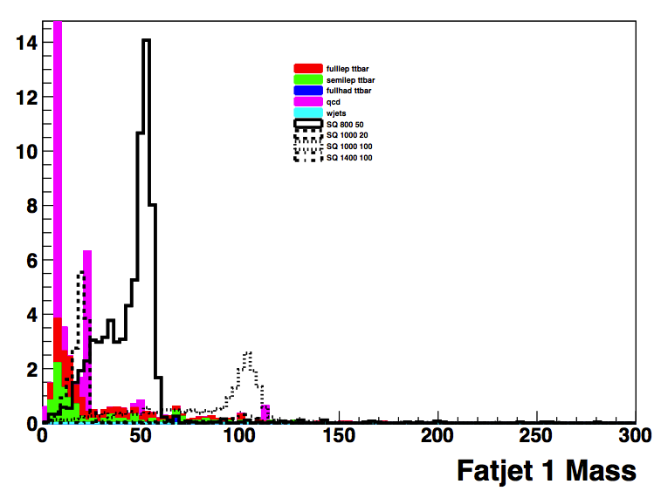
How can we use LSF to search for this signal?
Signals accessible at 8 TeV using more stringent hadronic cuts + cut on LSF for highest p_{T} and second highest p_{T} lepton
No. Events
Example signal peaks
Killed most QCD background events, preserved most signal
18

Slide 20
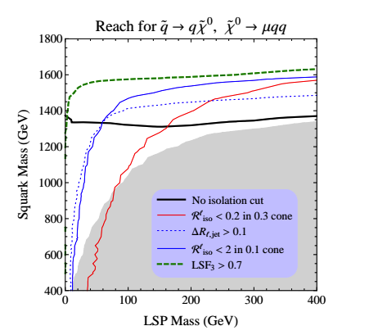
How much better is LSF?
Exclusion potential in m_{sq} m_{χ0} with LSF cut
Current exclusion at 95% CL
From paper jointly written with theorists - plot is generator level only (no detector simulation)
19

Slide 21
Summary
LSF works much better than lepton isolation for boosted signals
Next steps: apply LSF to real searches
Squark-neutralino analysis at 13 TeV, proposal in progress
Vector boson decay to HZ analysis at 8 TeV, analysis note setting limits on model in progress
20

Slide 22
Backup

Slide 23
LHC Facts
Circumference: 26 659 m
9300 magnets
Ultra high vacuum in the LHC
Proton beams over 100,000 times hotter than Sun
Cryogenic system at 1.9 K
Up to 600 million proton collisions/s
10,000+ computers
Notes:
Why would we expect the falsities

Slide 24
CMS Analysis Chain
Silicon pixel and strip tracker
Lead tungstate crystal ECAL
Brass/scintillator HCAL
Superconducting solenoid – 6 m internal diameter, 3.8 T
Muon system – gas-ionization detectors embedded in steel return yoke
Forward CALs
RAW data from CMS DAQ and Trigger System -> repacked based on trigger info -> reconstruction to Analysis Object Data -> Physics Analysis Toolkit (group level) -> ntuples (JHU level) -> analysis
Particle flow event reconstruction – info from all subdetectors reconstructed as electron, muon, photon, charged/neutral hadron; negative vector sum of all particles p_{T} labeled as MET
Pileup – contributions from inelastic pp interactions with same bunch crossing (in-time) or previous and next bunch crossing (out-of-time)

Slide 25
Hierarchy Problem and Supersymmetry
Expect large quantum contributions to square of Higgs boson mass should make it on the order of the Planck scale unless there is fine-tuning cancellation between quadratic radiative corrections and bare mass
BSM that predicts Higgs mass must account for this -> SUSY cancels loop diagrams
MSSM: every SM particle has superpartner(s), R-Parity for stability of proton, supersymmetry is a broken symmetry
Notes:
Why would we expect the falsities

Slide 26
Closer Look at R-Parity
R-parity associated with Z₂ subgroup of continuous U(1) R symmetry transformations
R-parity can be written as R_{p} = (-1)^{2S}(-1)^{3B+L} for spin S, baryon number B and lepton number L
Conservation of R-parity related to conservation of B and L which are important for stability of proton
Exact B or L conservation can take the place of R-parity conservation in ensuring stability of proton
Recipe for R-Parity Violating SUSY: Turn on different R-parity violating terms with restrictions to which terms can be turned on and how strongly

Slide 27

Definition of Lepton Isolation
Define variable to measure distance between leptons and other particles: ΔR = Δη + Δφ
Within fixed cone of ΔR, calculate pfiso: the smaller the value, the more isolated the lepton
6
Notes:
Study of smallest non-composite objects
Molecules>Atoms>Protons/electrons>.Quarks
Why->Analyzing universe we live in – experimental applications in many different fields as well
2 types of SM particles
One newly discovered particle!

Slide 28
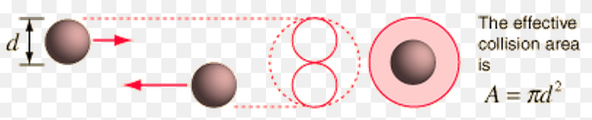
Calculating things in the SM
Particles collide, different things can happen
Governed by Quantum Mechanics → probabilties
production rate ~ cross section * luminosity (flux)
Cross section, classically:
effective area of collision
(a bit more complicated for field, e.g. Rutherford scattering)
Cross section, Quantum-Mechanically:
(Fermi's golden rule)
= Quantum-Mechanical amplitude

Slide 29
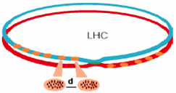
13 TeV LHC
2010-2012: Sqrt(s) = 7->8 TeV, L~6*10^33 cm⁻²s⁻¹, bunch spacing 50 ns
2014-2017 – Sqrt(s) = 13->14 TeV, L~1*10^34 cm⁻²s⁻¹, bunch spacing 25 ns
Luminosity: number of coillions produced in detector per cm² per s; N²/(t*S_{eff}) or number of protons squared divided by time between bunches and effective section of collision (4*Pi*16 microns)
http://www.lhc-closer.es/img/subidas/4_1_1_2.png

Slide 30
MC Samples
MC generator (MadGraph) -> Full Simulation of Detector (hadronize with Pythia) -> Physics Analysis Toolkit (group level) -> ntuples (JHU level) -> analysis

Slide 31
Lepton 2 Isolation

Slide 32
LSF 2

Slide 33
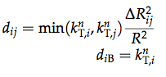
Jet Clustering
CA: k_{T}-like take constituent and cluster with its closest constituent in ΔR, repeat
Find d_{min} of all d_{ij} (distance between particles) and d_{iB} (distance between particle and beam) – done if d_{iB} and merged for min d_{ij}
Relies only on distance weighting (no momentum weighting)
Exclusive k_{T} – pairs all constituents of CA8 jet with closest neighbor to create pseudoparticle, stops when n are left (in our case 3)

Slide 34
LSF for Analysis

Slide 35
Confidence Level
95% Confidence Level: of a group of experiments, each producing a confidence interval, 95% will find (or exclude) s

Slide 36
Squark-Neutralino Model
sup, sdown, sstrange, scharm all have m_{sq}
Neutralino has m_{neu} – mix between Z, H, photon superpartners
Gluino at 2 TeV
Production mediated by gluino or gluon, couples to W and Z but weakly – must be RPC until neutralino level
Ignore gluino production
100% branching ratio to neutralino although if there were other possibilities its ok as long as its small
Effective theory – stop and sbottom must be higher than mass limit
NOT natural SUSY
Violate LQD, neutralino decays to muqqbar 100%
L and Q SU(2) doublets, D is D so you could have muud or nudd – SU(2) symmetry saying it should be this way but that’s broken so its possible to have just muud

